Slide 1
SDLC and Related Methodologies

Slide 2
Contemplative Questions
What are the various approaches to developing Information Systems?
Is there one best way?
What is the difference between techniques, methodologies and tools?
What does the popular term “SDLC” actually mean?

Slide 3
SDLC
SDLC stands for
Systems
Development
Life
Cycle
What does it mean?

Slide 4
SDLC
SDLC stands for
Systems Development Life Cycle
First, SDLC is a Life Cycle.
All systems have a life cycle or a series of stages they naturally undergo.
The number and name of the stages varies, but the primary stages are conception, development, maturity and decline.
The systems development life cycle (SDLC) therefore, refers to the development stage of the system’s life cycle.
Why are we so interested in the development stage? What about conception, maturity and decline?
Notes:
‹#›
Development stage is critical. For example, learning behavior of humans is heavily influenced by their development period (and is the reason why money and effort is probably more effective in early stages of development). In much the same way, the success or failure of an information systems and the amount of maintenance required is dependent on the events during development.

Slide 5
Methodologies
Is there a difference between the term SDLC and the term ‘methodology’?
Whereas the SDLC refers to a stage all systems naturally undergo, a methodology refers to an approach invented by humans to manage the events naturally occurring in the SDLC.
A methodology is, in simple terms, a set of steps, guidelines, activities and/or principles to follow in a particular situation.
Most methodologies are comprehensive, multi-step approaches to systems development
There are many methodologies out there. See www.methodology.org .

Slide 6
SDLC vs. Methodology
It is confusing, but unfortunately, the term SDLC is frequently used synonymously with the waterfall or traditional approach for developing information systems.
“The Waterfall approach”
This approach essentially refers to a linear sequence of stages to develop a system from planning to analysis to design to implementation.
Stages are followed from beginning to end.
Revisiting prior stages is not permitted.

Slide 7
Approaches to Systems Development
Process-Oriented Approach
Focus is on flow, use and transformation of data in an information system
Involves creating graphical representations such as data flow diagrams and charts
Data are tracked from sources, through intermediate steps and to final destinations
Natural structure of data is not specified
Notes:
‹#›

Slide 8
Approaches to Systems Development
Data-Oriented Approach
Depicts ideal organization of data, independent of where and how data are used
Data model describes kinds of data and business relationships among the data
Business rules depict how organization captures and processes the data
Notes:
‹#›

Slide 9
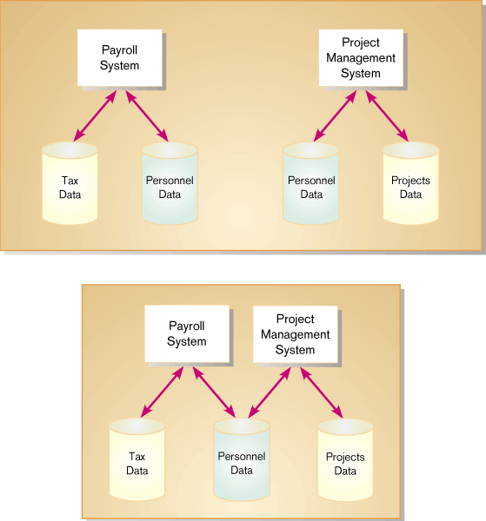
Approaches to Systems Development
Which is better, the Process Approach or the Data Approach?
Process Approach:
“Let’s look at all of our processes. Processes take precedence over data. Get the processes correct first. Then we’ll address what data is important.”
Data Approach:
“Forget the processes, let’s look at the data. Data comes first. Get the data correct, then see how the processes actually use the data.”
Notes:
‹#›

Slide 10
Databases and Application Independence
Database
Shared collection of logically related data
Organized to facilitate capture, storage and retrieval by multiple users
Centrally managed
Designed around subjects such as Customers or Suppliers
Application Independence
Separation of data from the applications, e.g.
Payroll data is part of the enterprise-wide data model and can be used by many systems, not just the Payroll System
Notes:
‹#›

Slide 11
Systems Development Life Cycle
Every textbook has different names for the stages of the SDLC
Usually they stages are
Planning (just after Conception)
Analysis
Design
Implementation
Maintenance (starting Maturity)
1.‹#›
Notes:
‹#›

Slide 12
Systems Development Life Cycle
This text highlights 6 distinct phases:
Project Identification and Selection
Project Initiation and Planning
Analysis
Design
Implementation
Maintenance
Notes:
‹#›

Slide 13
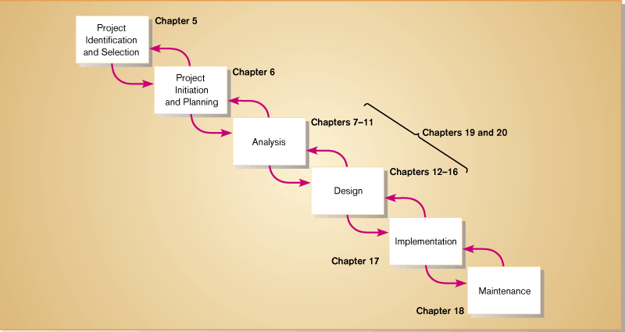
Stages of the SDLC
IS 422
Systems Design
IS 421
Systems Analysis

Slide 14
Phases of the Systems Development Life Cycle
Project Identification and Selection
Two Main Activities
Identification of need
Prioritization and translation of need into a development schedule
Helps organization to determine whether or not resources should be dedicated to a project.
Project Initiation and Planning
Two Activities
Formal preliminary investigation of the problem at hand
Presentation of reasons why system should or should not be developed by the organization
Notes:
‹#›

Slide 15
Systems Development Life Cycle
Analysis
Study of current procedures and information systems
Determine requirements
Study current system
Structure requirements and eliminate redundancies
Generate alternative designs
Compare alternatives
Recommend best alternative
Notes:
‹#›

Slide 16
Systems Development Life Cycle
Design
Logical Design
Concentrates on business aspects of the system
Physical Design
Technical specifications
Implementation
Implementation
Hardware and software installation
Programming
User Training
Documentation
Notes:
‹#›

Slide 17
Systems Development Life Cycle
Maintenance
System changed to reflect changing conditions
System obsolescence
A good way to learn the stages of the SDLC is to create deliverables (output) of each stage in the process.
Notes:
‹#›

Slide 18
Alternative Approaches
Prototyping
Building a scaled-down working version of the system
Advantages:
Users are involved in design
Captures requirements in concrete form
Rapid Application Development (RAD)
Utilizes prototyping to delay producing system design until after user requirements are clear
Notes:
‹#›

Slide 19
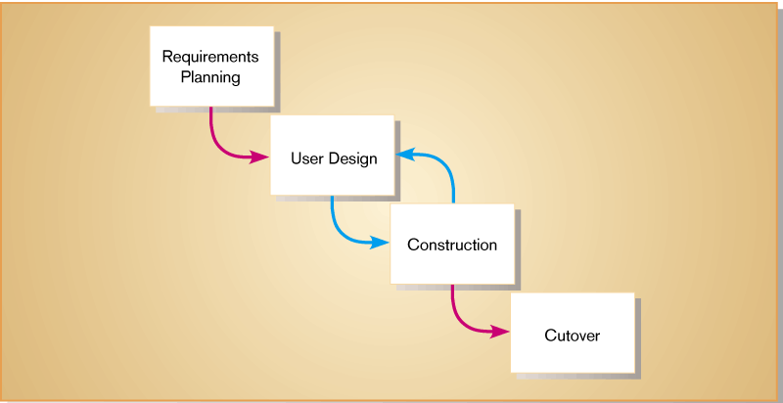
Prototyping
Fig. 1-6

Slide 20
Alternative Approaches
Joint Application Design (JAD)
Users, Managers and Analysts work together for several days
System requirements are reviewed
Structured meetings
Notes:
‹#›

Slide 21
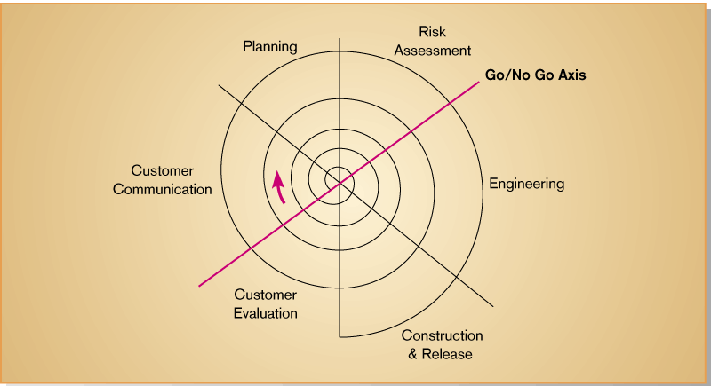
Alternative Approaches
Evolutionary or spiral methodology
The *** never gets done! Different versions, always in different stages.
Notes:
‹#›

Slide 22
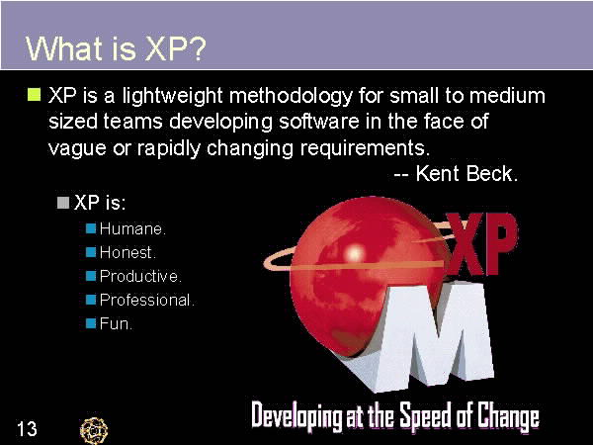
Agile Methods

Slide 23
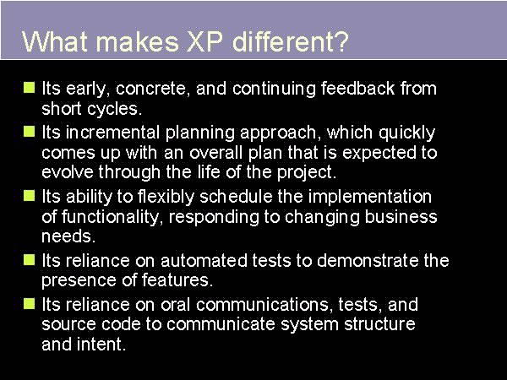
What makes it Different?

Slide 24
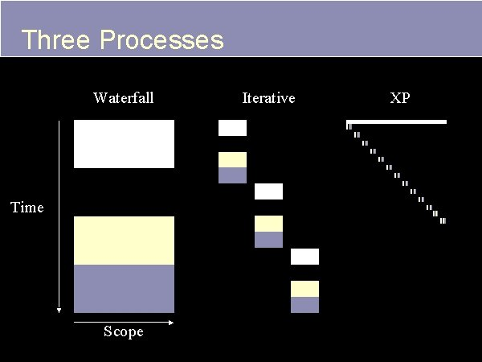
Three Processes

Slide 25
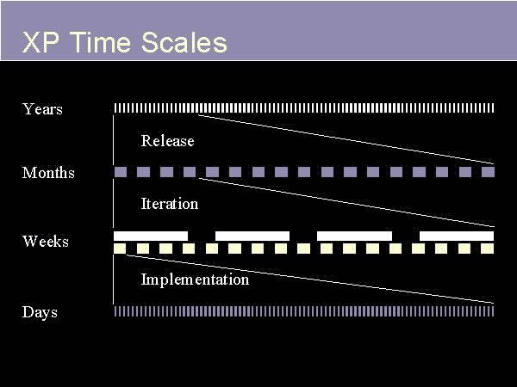
Time Scales

